Slide 1
README for Project 1
AI ToolKit
Fall Semester, 2023

Slide 2

Task: Fashion-MNIST classification
To Do: Train a model that can classify each fashion item’s categories !
i.e., t-shirts, shoes, pants…

Slide 3

Data Specification
Input : 28 x 28 sized gray-scale images
Output : 10-dimensional vector, where 10 denotes the class numbers.
We provide train and validation data through .npz format.
train.npz & val.npz are provided.
When npz_fp="train.npz", you can read this file with below code.
[HINT] In provided test.ipynb file, please check the cell named Define Test Dataset class

Slide 4
What should I do for this project?
Build your code for…
Custom dataset & dataloader.
Data augmentation.
Neural network model
Model training
Model saving
**Refer to the code materials provided in class**
** Use GPU for your training! (set runtime type of Google Colab)**
** Your model should be based on course material until 25th Oct (i.e., MLPs, CNNs)**
**Your model parameter number should not exceed 1 million**
Check your parameter number with def count_parameters(model): in utils.py

Slide 5
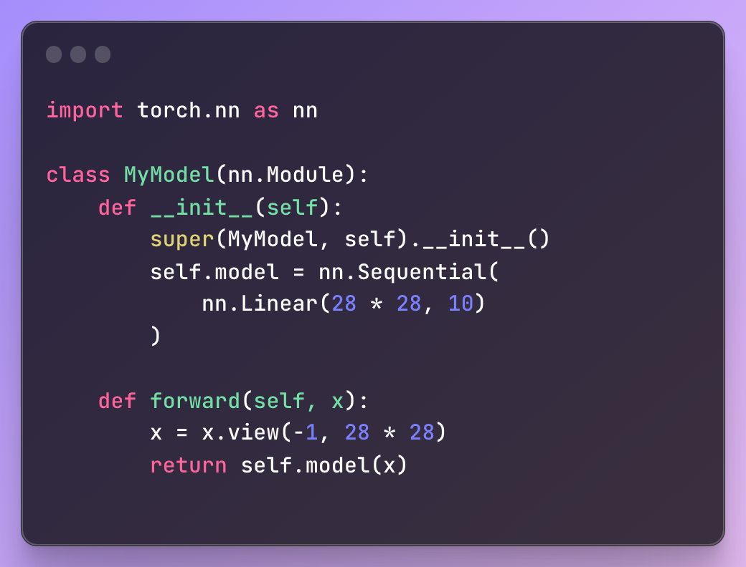
What should be submitted?
model.py
A python code defining your model class.
Your model class name should be MyModel.

Slide 6
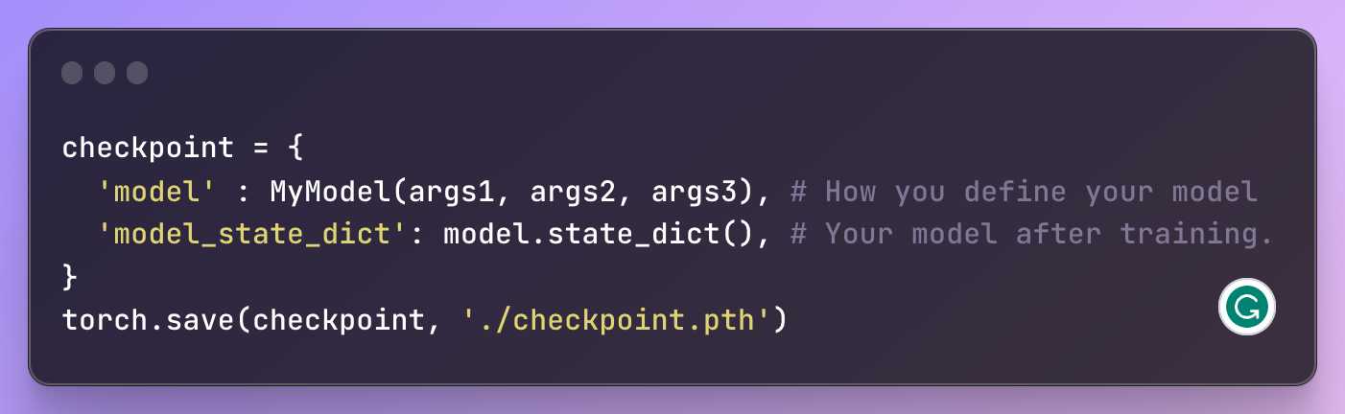
What should be submitted?
2. checkpoint.pth
.pth file that saves your model after training.
After finishing your training, use below code to save your model.
Here, MyModel(args1, args2, args3) should be modified depending on how your model should be defined.
The saved './checkpoint.pth' will be read by def load_checkpoint(filepath, device) in utils.py

Slide 7
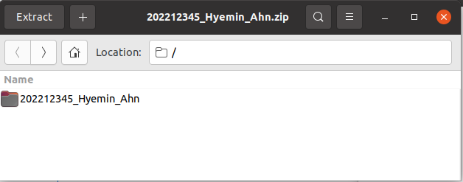
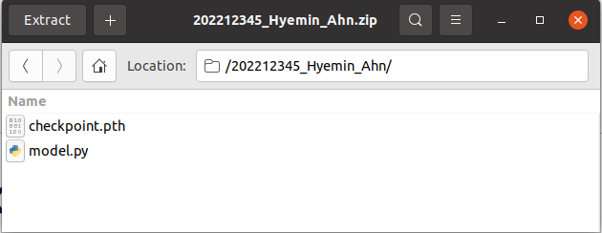
What should be submitted?
Build a directory named [student id]_[first name]_[last name].
For instance, my directory would be 202212345_Hyemin_Ahn
Please make your directory with this name format.
We are grading 120 students, so directory name out of this format might not be counted for grading.
Put model.py and checkpoint.pth to that directory
Zip that directory, and also name the zip file as [student id]_[first name]_[last name].zip ex) 202212345_Hyemin_Ahn.zip file

Slide 8
How to run test.ipynb in Google Colaboratory
Check if your runtime type is on “GPU” in Google Colab.
Connect to the notebook to the Colab server.
Upload (utils.py, model.py, checkpoint.pth, val.npz) to the file system.
Run the code and check if everything works smoothly.
Detailed how-to will be shown in the class!

Slide 9
Deadline and where to submit?
Deadline: 23:59, 5th November
Submit it to…
Assignment tab in Blackboard System

Slide 10
Any Questions?

